Slide 1
Content Recommender System
Presentation by:
Bhumika Singhal
Namita Shukla
Riya Dholakia
TA: Utkarsh Kashyap
Professor: Dr. Lyle Ungar

Slide 2
Motivation and Real World ML
Problem Statement:
Recommending content efficiently and effectively for sparse data.
Motivation:
Consumer Driven Economy
Need of the hour for Media based Companies
Posing as an ML problem:
Predicting ratings for the items that the user has not yet rated and recommending the most suited item for the particular user.

Slide 3
Dataset
Jester Joke Dataset (Ken Goldberg, AUTOLab, UC Berkeley)
100 jokes
24,983 users
Ratings Range: -10 to 10
Value "99" corresponds to "null" = "not rated"

Slide 4
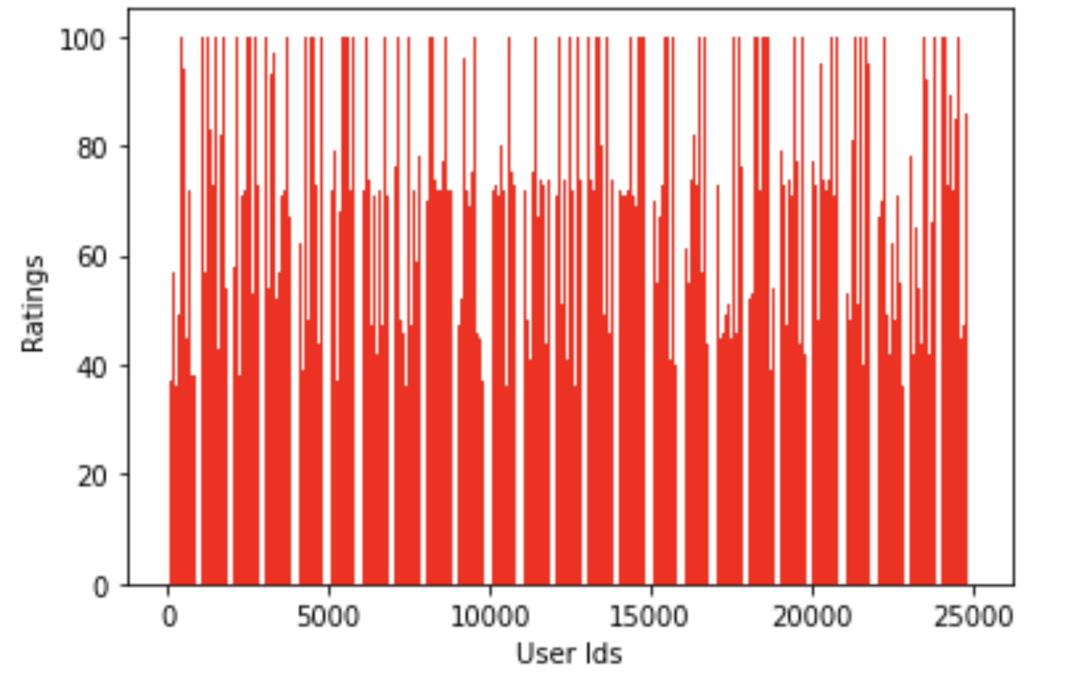
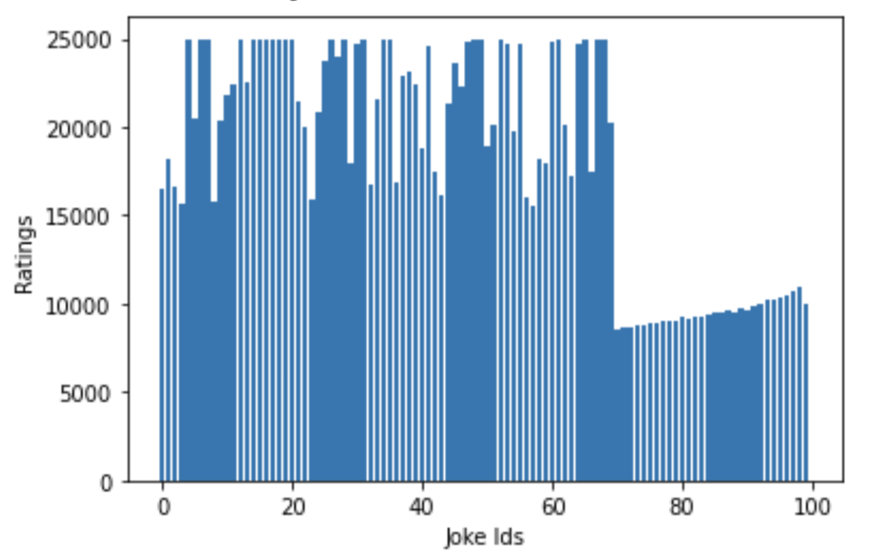
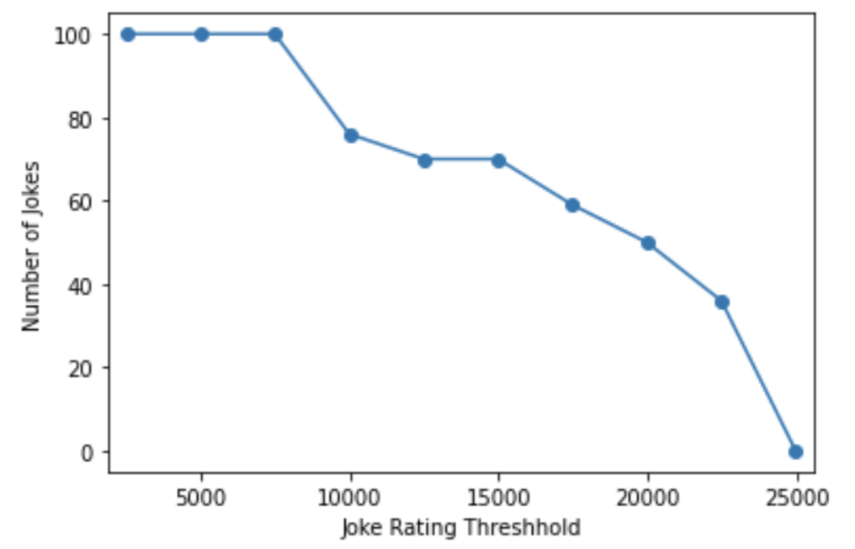
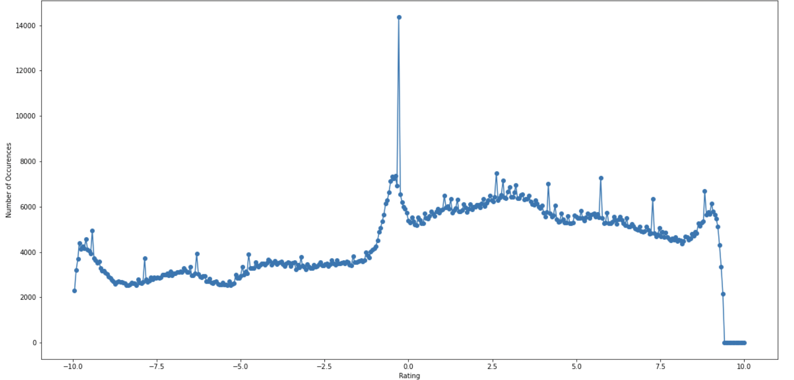
Interpreting Dataset

Slide 5
Data Preprocessing
Sparsity
Sparse matrices can’t be plugged in sklearn directly
Added more sparsity: 12.5%, 25%, 30%
Dense Matrix
Negative Ratings
Scaling for NMF and Neural Based

Slide 6
Similarity Metrics and Models
Similarity Metrics:
Manhattan Similarity
Cosine Similarity
Pearson Correlation Similarity
Baseline Model : Item Based Mean Imputation
Memory Based Models:
KNN
Soft KNN
Soft KNN with Item Baseline
Model Based
Matrix Factorization
NMF
Neural Based
Ensemble: NMF + Soft KNN with Item Baseline
Equal weighting
Regression based

Slide 7
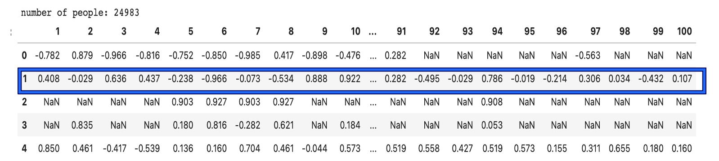
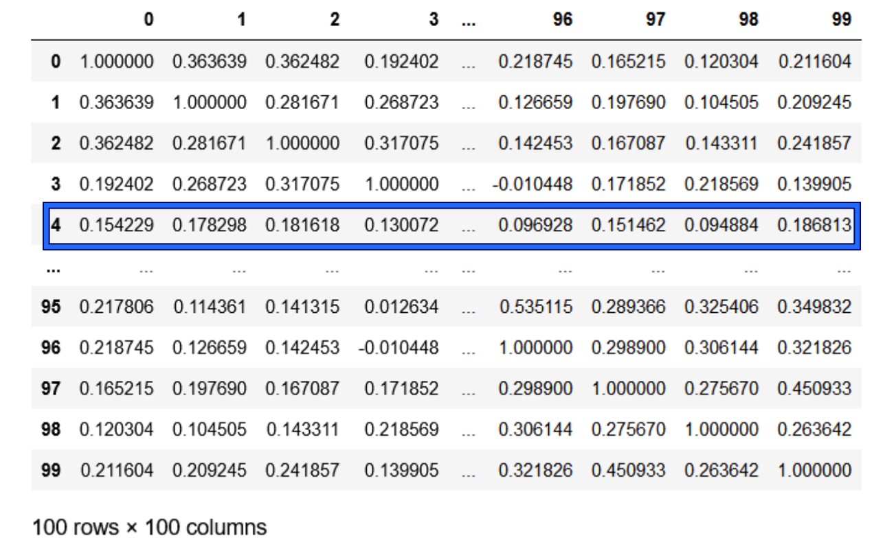
Neural Based Embedding
Input for training: User Embedding + Joke Embedding for rating, Output: Rating
Calculating User Embedding : Calculating Joke Embedding :
User 2 Embedding in Jokes dataset Joke 5 Embedding in Joke Sim Matrix

Slide 8

Neural Based Embedding
Input Embedding for Rating (2,5) [User 2 and Joke 5]

Slide 9
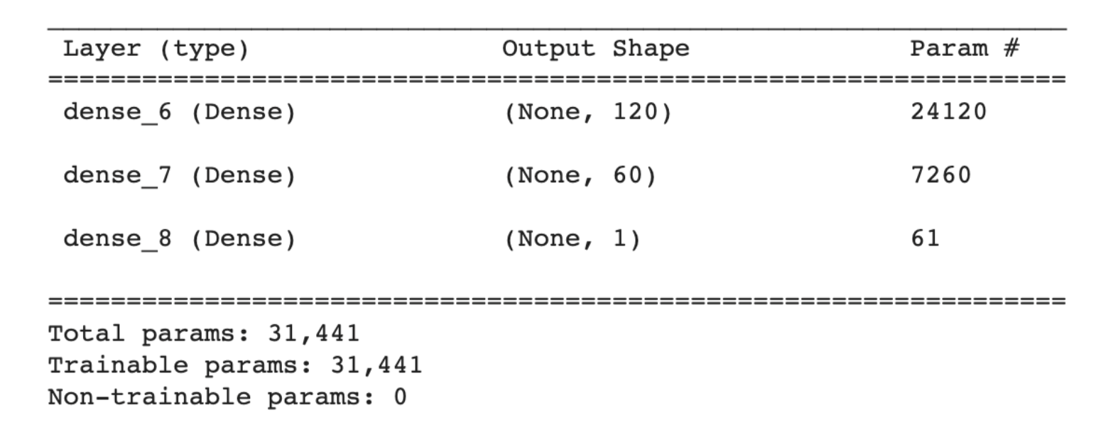
Neural Based Embedding
Architecture:

Slide 10
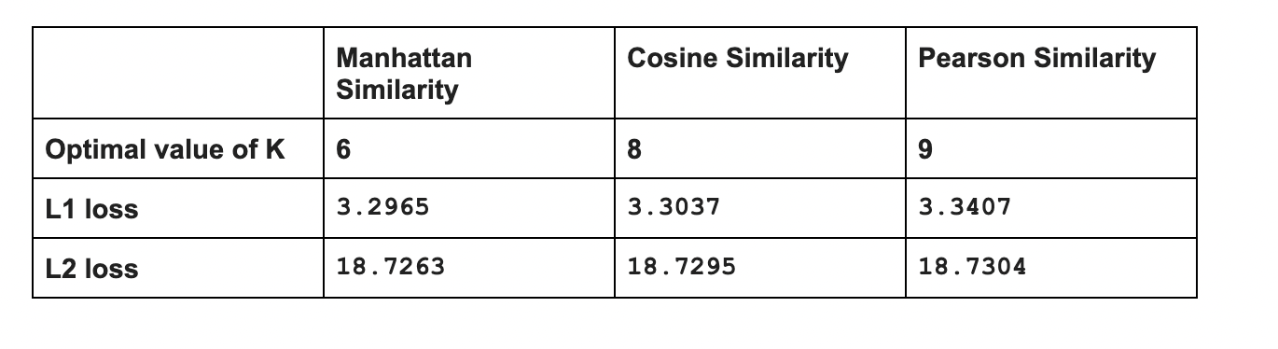
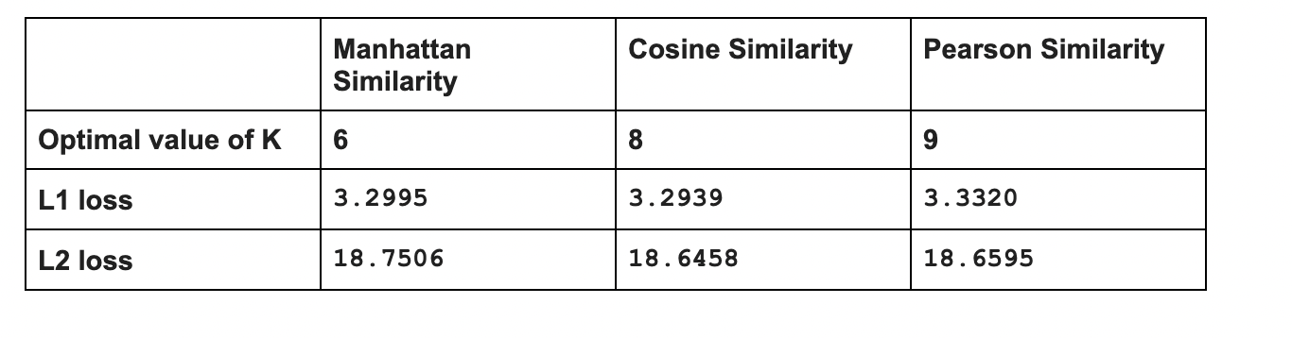
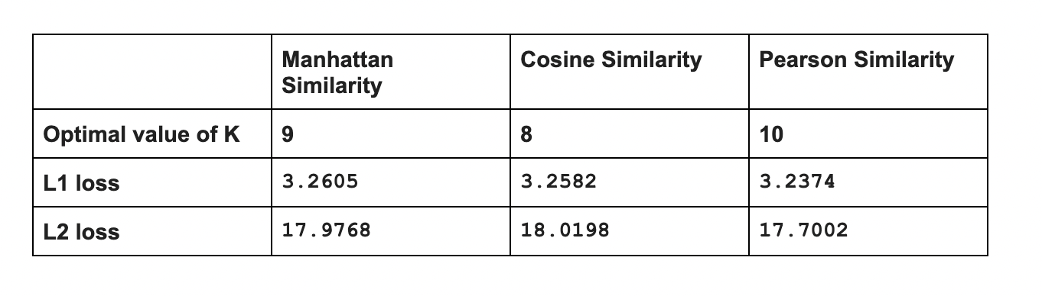
Results for Memory Based
KNN:
Soft KNN:
Soft KNN
With Item
Based:

Slide 11
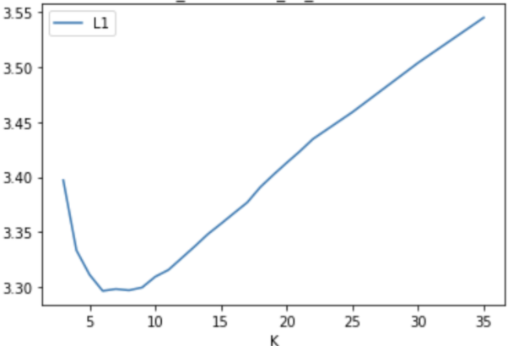
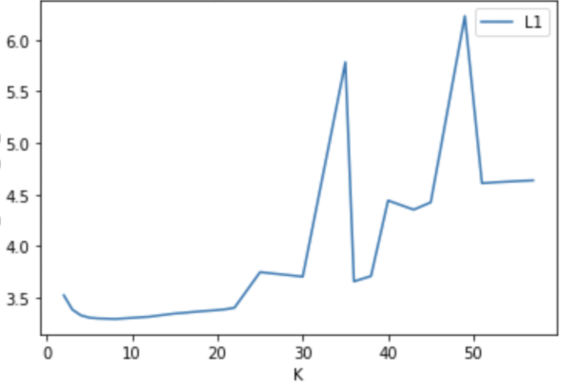
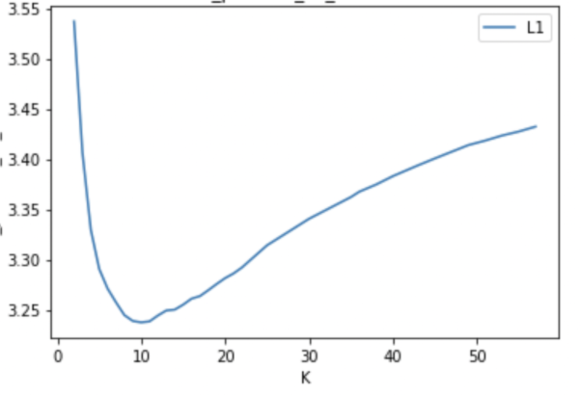
Hyperparameter Tuning for Memory Based
KNN - Manhattan Similarity
Soft KNN - Cosine Similarity
Soft KNN(item baseline) - Pearson Similarity

Slide 12
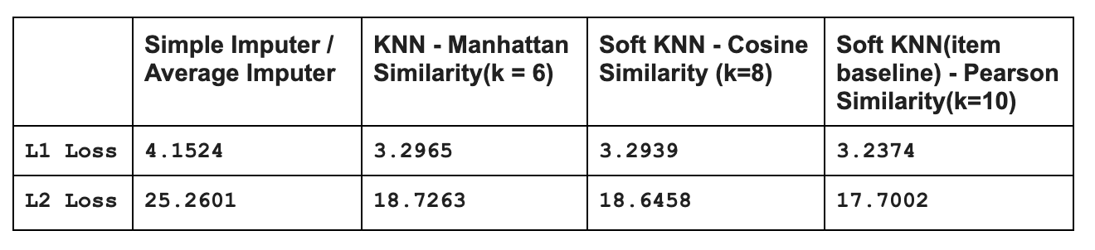
Results for Memory Based Contd…
Comparison with Baseline:

Slide 13
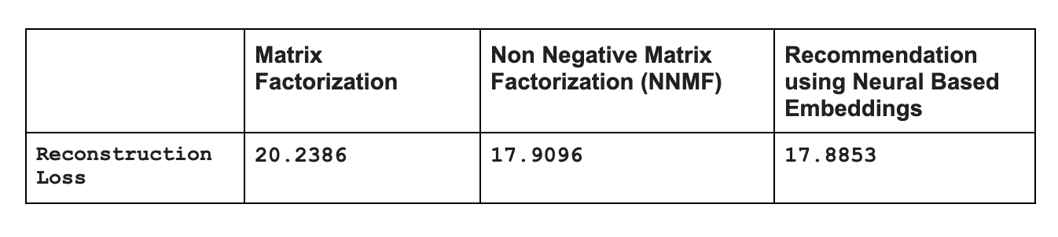
Results for Model Based

Slide 14
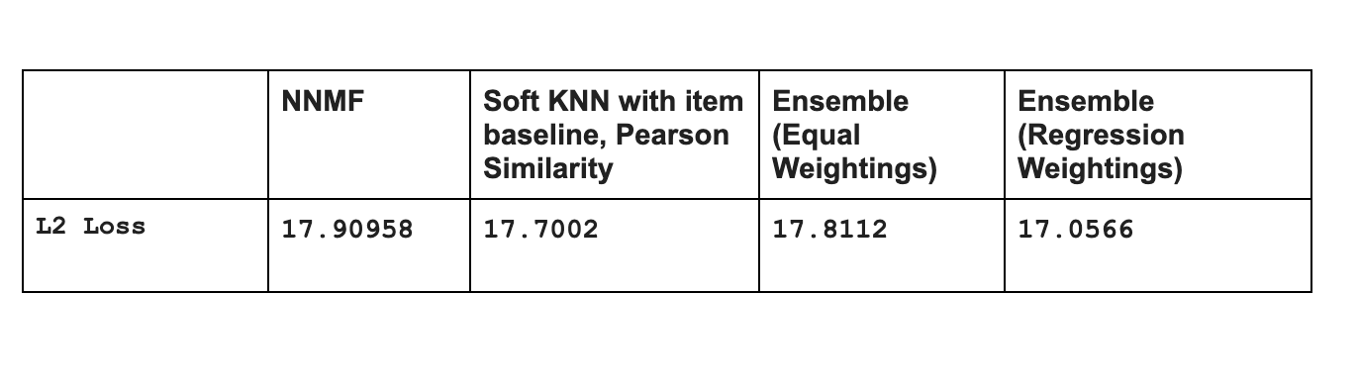
Results for Ensemble Method

Slide 15
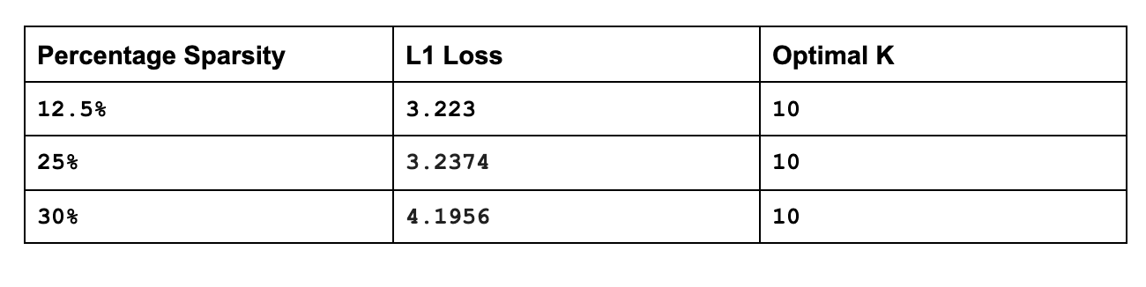
Effects of Sparsity
Soft KNN (item baseline adjusted) with Pearson Correlation similarity

Slide 16
Challenges and Insights
Scale Invariant in Ratings
Negative ratings doesn’t impact similarity metrics
Simple Mean Imputation Challenges
Soft KNN with User Baseline Item Baseline
Ensemble: Average Based Regression Based

Slide 17
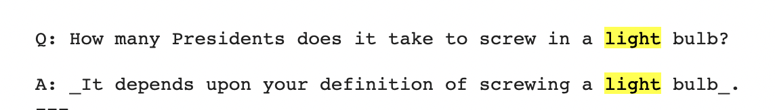
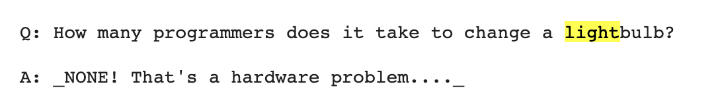
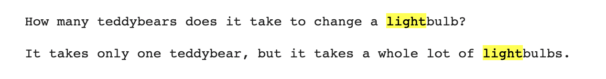
Recommendations (user 7889)
Highly Rated:
What we recommended:

Slide 18
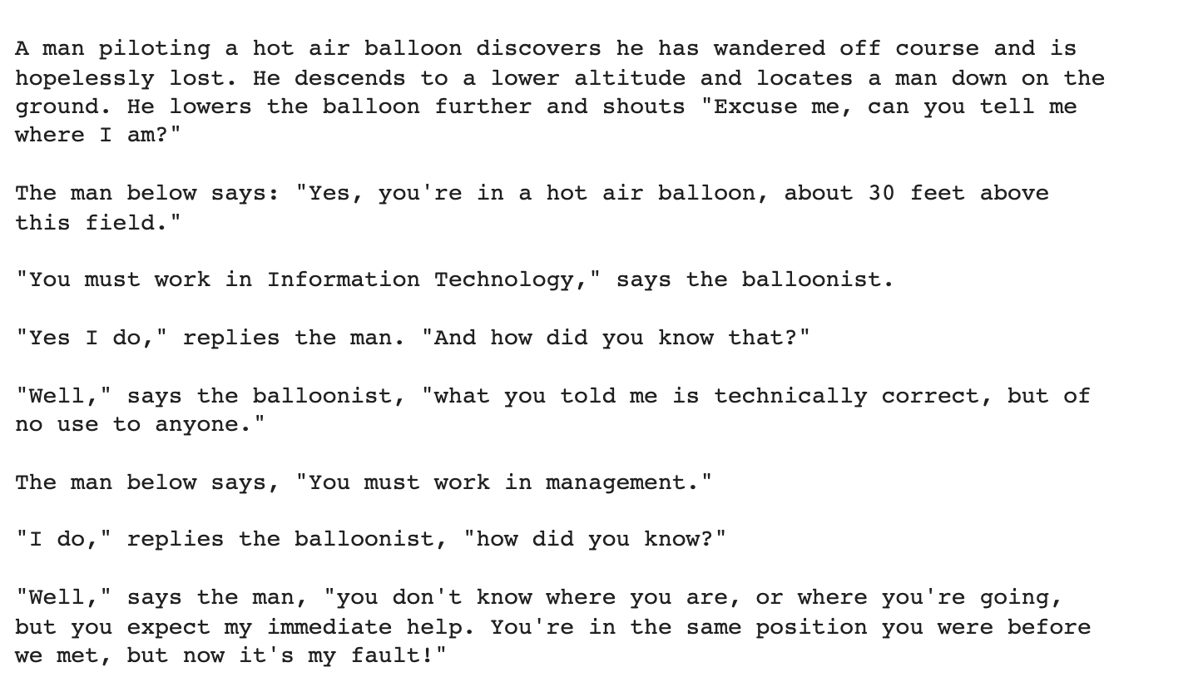
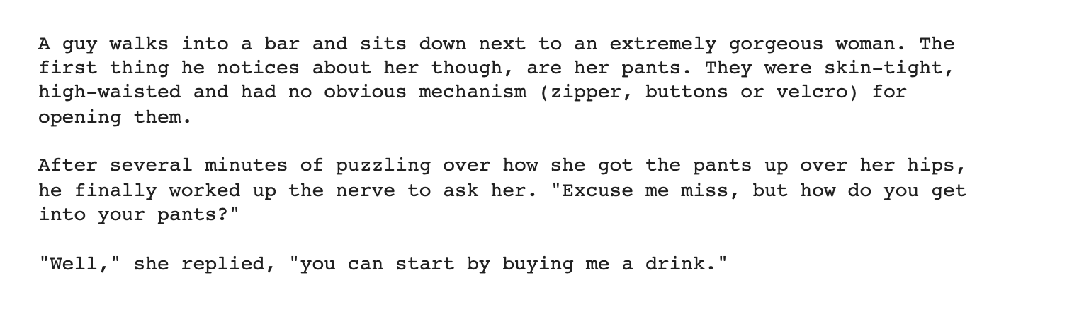
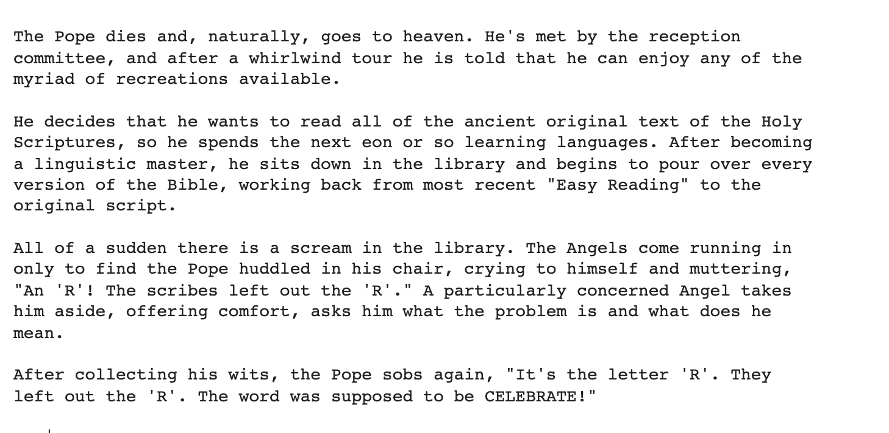
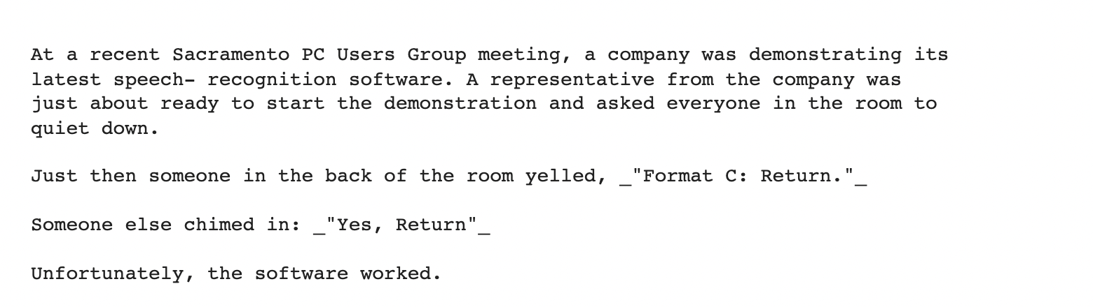
Recommendations (user 571)
Highly Rated:
What we recommended:

Slide 19
Thank You

